Slide 1


Topic: Introduction to Personal Development
Unit 1.1 Why to focus on personal development
Prepared by the research team

Slide 2
Welcome!!
Unit 1.1 Why to focus on personal development

Slide 3
Learning outcomes
01
Students will be able to demonstrate the basic knowledge and understanding of personal development journey.
Students will be able to understand the importance
of starting and continuously engaging in personal development
02

Slide 4
What is personal development?
Process - managing ourselves – to complete the daily tasks.
Complete / Achieve things - to be successful.
Developing necessary skills to be productive / efficient / effective.

Slide 5
Personal development helps developing all the areas of life and is therefore is a personal lifelong journey.
It is high time that journey of Personal development needs to be prioritized.
The journey of Personal development is an ongoing process of constant learning. It give the opportunity to appraise strength and weaknesses and to polish and utilize them.
The paybacks of this struggle is that individual grow as a person while growing skills, one improves self-awareness, and gain self confidence.

Slide 6
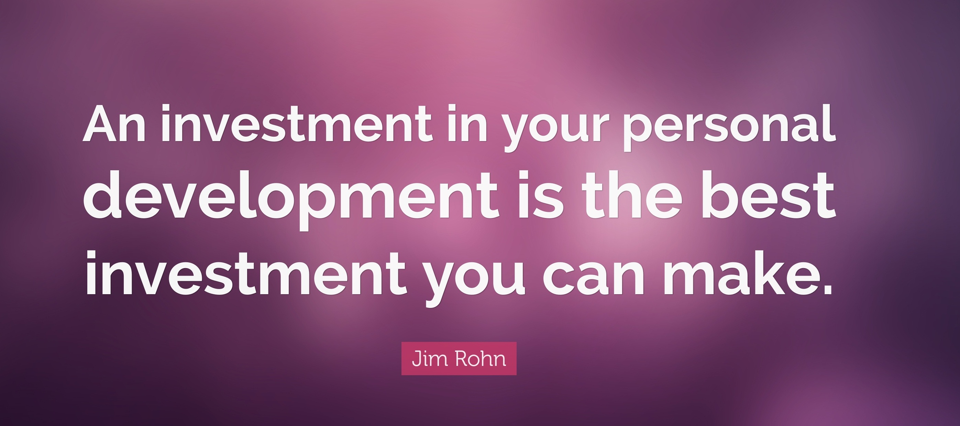
WHEN EMBARKING ON THE JOURNEY OF PERSONAL DEVELOPMENT, KEEP IN MIND THE FOLLOWING STEPS:
Establish the goals you want to reach in all areas of your life
Make time for nurturing your strengths
Look for the weaknesses/areas that need improvement in order for you to reach these goals
Recognize the different prospects to develop the identified areas of improvement.
Set up your plan of action for improving the identified areas of improvement.
Keep record of the outcomes of your development.
Reflect on your outcomes counter to your goals

Slide 7
Do you know which sets of skills will facilitate you in different areas of life?

Slide 8
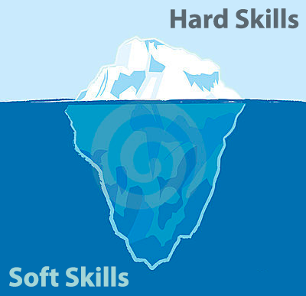

Slide 9
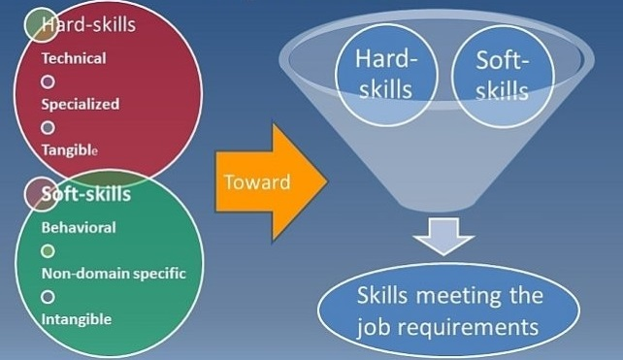

Slide 10
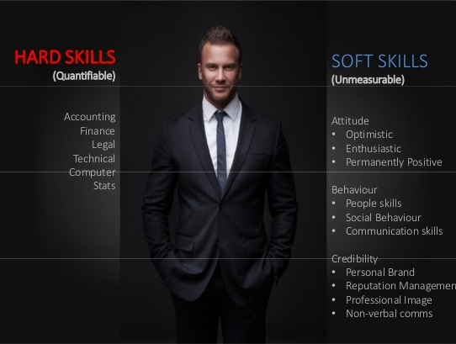

Slide 11
Conclusion
Personal Development helps to continue to set and achieve goals
PD helps us to be able to prioritize.
PD gives us more confidence
Making a commitment to lifelong learning in support of both the universities’ / organizations’ goals and your own goals
Developing your personal productivity skills to manage both your time and your commitments.

